Slide 1

Race, privilege and climate justice
Jeremy Williams

Slide 2
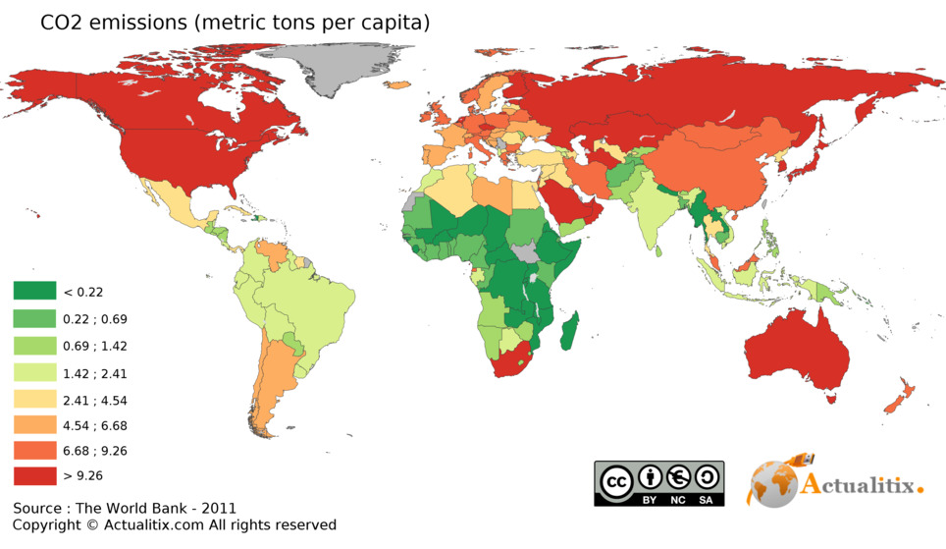

Slide 3
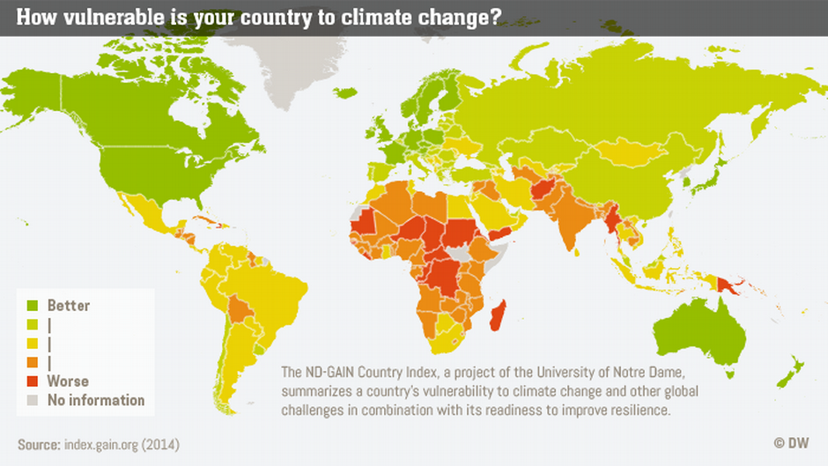

Slide 5
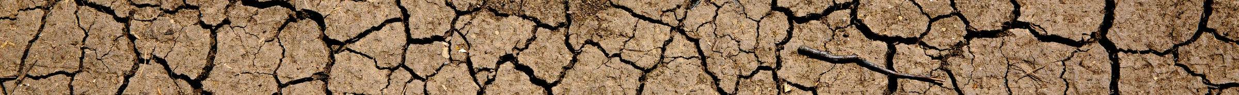
“We basically have three choices:
mitigation, adaptation and suffering.
We’re going to do some of each.
The question is what the mix is going to be.
The more mitigation we do,
the less adaptation will be required
and the less suffering there will be.”
John Holdren

Slide 6

To be climate privileged is to be
untroubled by climate change,
to have no personal experience
of its negative effects.

Slide 7
To be climate privileged is to be
untroubled by climate change,
to have no personal experience
of its negative effects.
If you have never experienced
climate change as harm, as loss,
as injustice or as violence,
you are privileged.

Slide 8
Three kinds of racism
Individual

Slide 9
Three kinds of racism
Individual
Institutional
“The collective failure of an organisation to provide
an appropriate and professional service to people
because of their colour, culture, or ethnic origin.”
(Stephen Lawrence Enquiry)

Slide 10
Three kinds of racism
Individual
Institutional
Structural
“Racism must be understood in terms of its consequences,
not as a matter of intentions or belief.”
(Howard Winant)

Slide 11

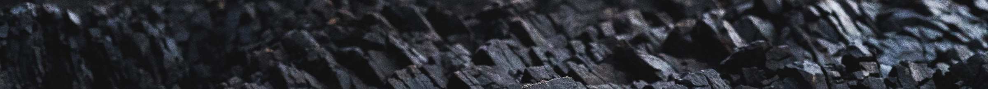

Slide 12
Slavery
Empire
Colonialism
Industry
Climate change

Slide 13
Across the world, which of the following broad
ethnic groups do you think is most vulnerable
to the negative impacts of climate change?
White: 31%
Black: 15%
Asian: 10%
Arab: 1%
All groups equally vulnerable: 28%
Christian Aid / ComRes 2020

Slide 14
"To white people who care about
maintaining a habitable planet,
I need you to become actively anti-racist.
I need you to understand that our racial
inequality crisis is intertwined
with our climate crisis.
If we don’t work on both,
we will succeed at neither."
Ayana Elizabeth Johnson

Slide 15
Race, privilege and climate justice
Jeremy Williams

Slide 16
Wealth is treacherous, and the arrogant are never at rest.
They open their mouths as wide as the grave, and like death, they are never satisfied.
In their greed they have gathered up many nations and swallowed many peoples.
How much longer can this go on?

Slide 17
They have plundered many nations,
And filled the earth with violence.
They build big houses with money gained dishonestly.
They believe their wealth will buy security.
How much longer can this go on?

Slide 18
How long, O Lord, must I call for help?
But you do not listen!
“Violence is everywhere!” I cry,
but you do not come to save.
Must I forever see these evil deeds?
Why must I watch all this misery?
How much longer can this go on?

Slide 19
But I have heard all about you, Lord.
I am filled with awe by your amazing works.
In this time of our deep need, help us again as you did in years gone by.
And in your anger, remember your mercy.
Amen.

